Slide 1
You will now see a series of artworks for 2 minutes each. The robot will first take a minute to describe what it knows about the painting. Please stay silent while the robot talks. When it is done, the screen will indicate that it is your turn.
During your turn, please describe the artwork. It is OK to repeat things that the robot has said. Speak in a natural way, but be clear and do not mumble.
When your minute is up, the next artwork will be displayed and the robot will begin to talk.

Slide 2
Please wait for the robot to set up.

Slide 3

Robot’sTurn

Slide 4
Your Turn

Slide 5
Time’s up
The next artwork will appear shortly.

Slide 6

Robot’s Turn

Slide 7
Your
Turn

Slide 8
Time’s up
The next artwork will appear shortly.

Slide 9
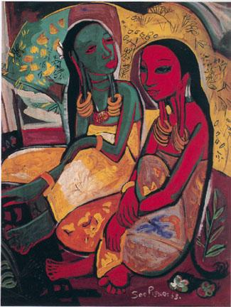
Robot’s Turn

Slide 10
Your
Turn

Slide 11
Time’s up
The next artwork will appear shortly.

Slide 12
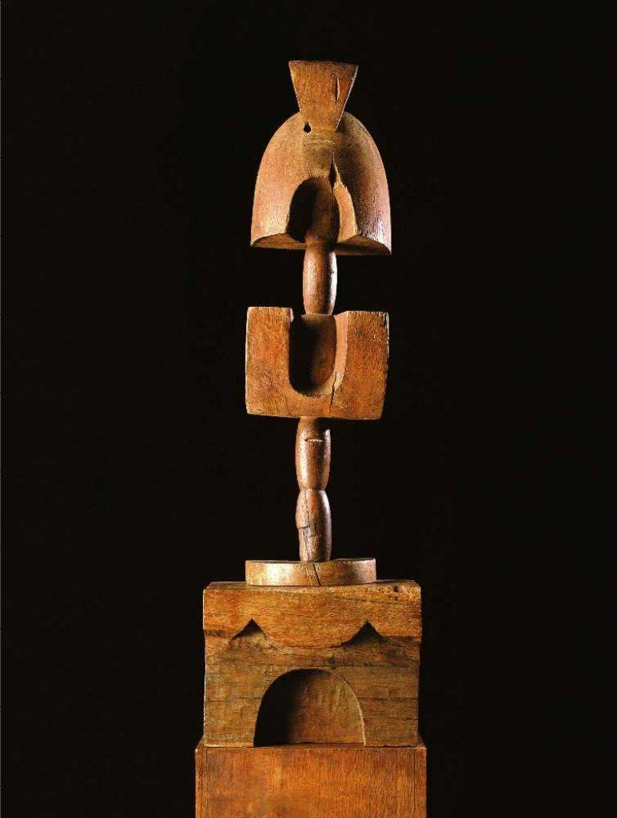
Robot’s Turn

Slide 13
Your
Turn

Slide 14
Time’s up
The next artwork will appear shortly.

Slide 15
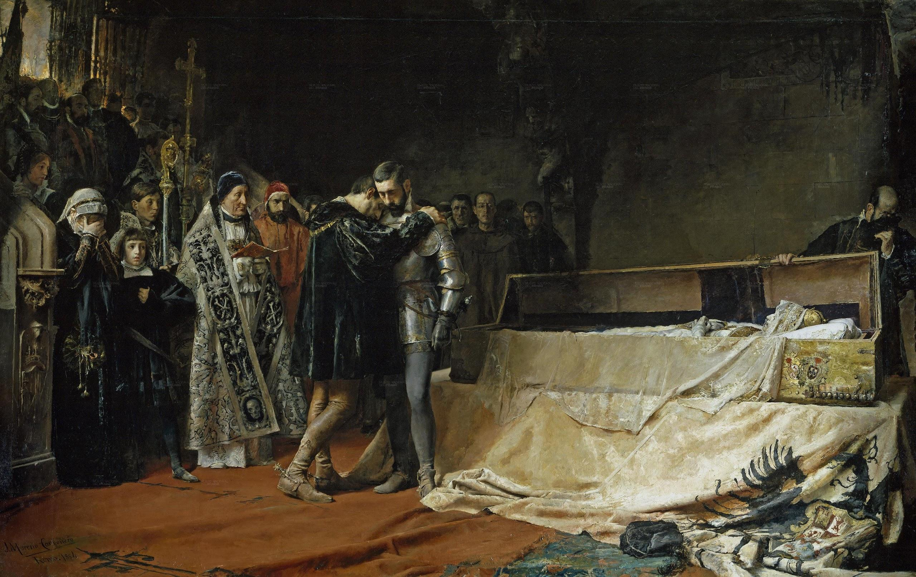
Ro-bot’s Turn

Slide 16
Yo-ur Turn

Slide 17
Time’s up
The next artwork will appear shortly.

Slide 18
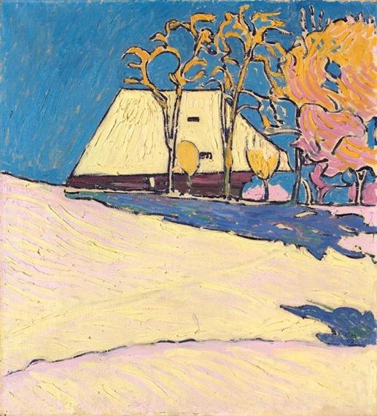
Robot’s Turn

Slide 19
Your
Turn

Slide 20
Time’s up
The next artwork will appear shortly.

Slide 21
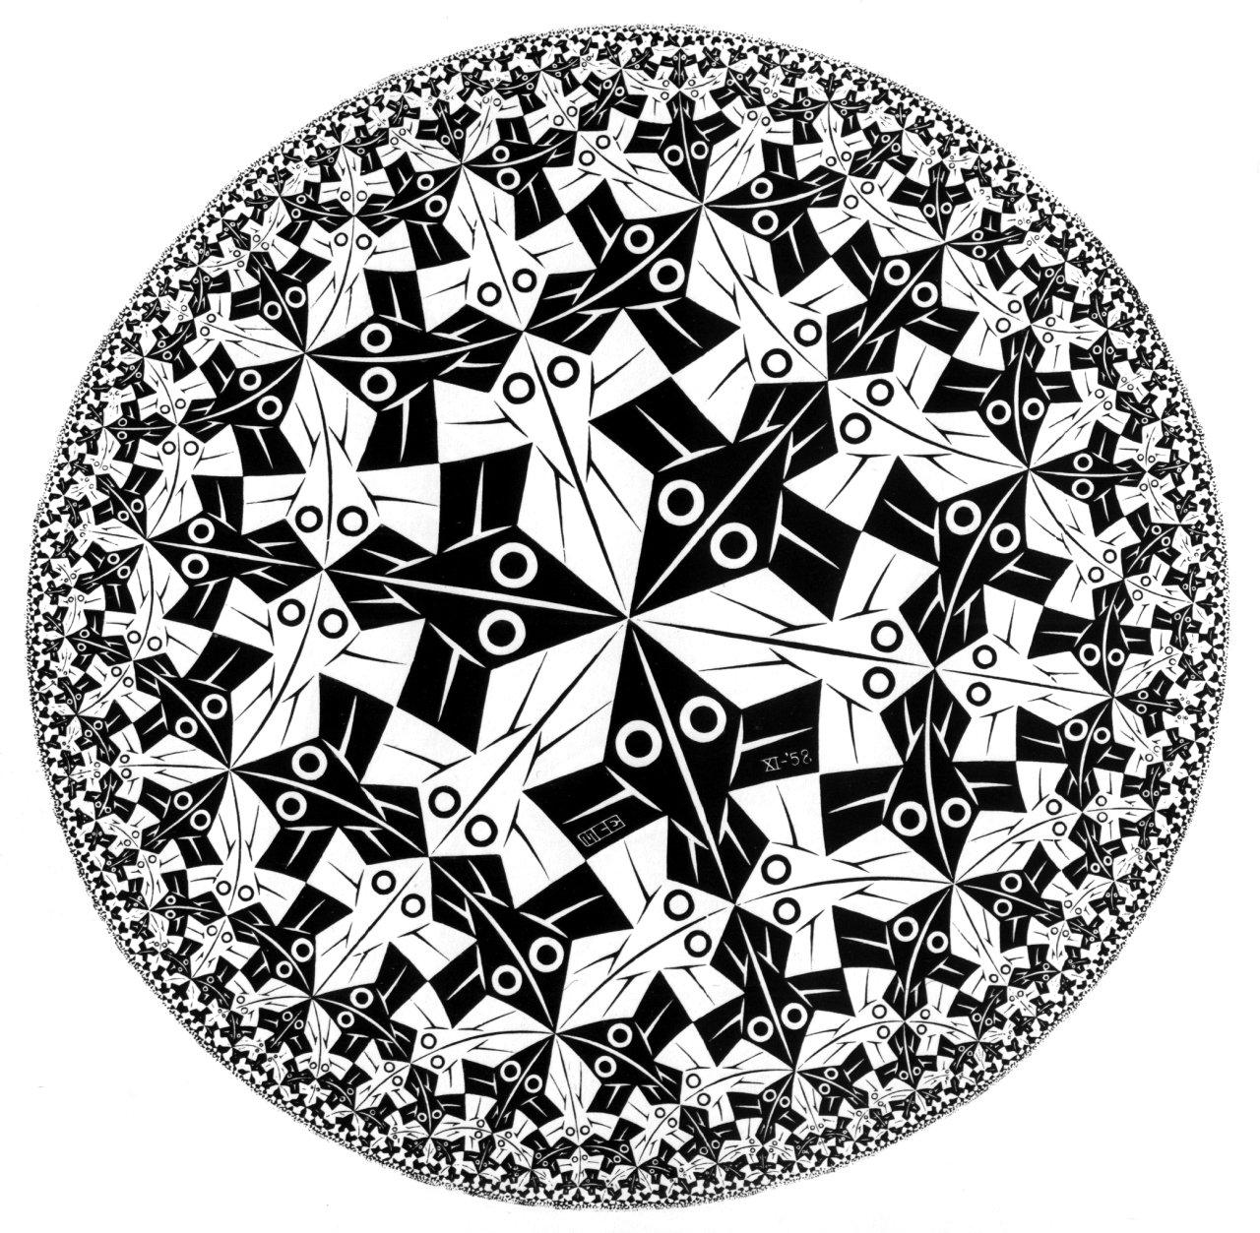
Robot’s Turn

Slide 22
Your
Turn

Slide 23
Time’s up
The next artwork will appear shortly.

Slide 24
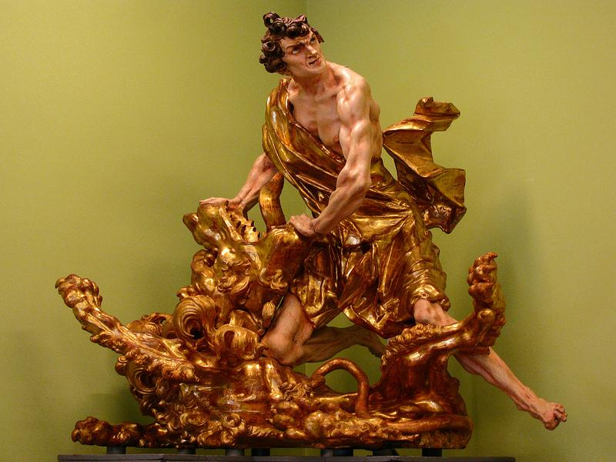
Robot’s Turn

Slide 25
Your
Turn

Slide 26
All done!
The experimenter will now be notified
and will come to get you shortly.
Thank you for your time.

